Slide 1
CSE 316 · OPERATING SYSTEMS · LPU
Thread
Synchronization
Visualizer 🧵
An interactive browser-based tool that brings OS concurrency primitives to life — in real time.
React 18
Vite 5
Tailwind CSS
Framer Motion
Vercel
Swipe to explore →

Slide 2
🤯
The Problem with OS Theory
Textbooks draw static semaphore diagrams. You nod along... but do you really get it?
I didn't — so I built something that shows you instead.
🔴 Semaphores blocking threads in real-time FIFO queues
🔒 Mutex lock ownership transferring between threads live
📦 Producer-consumer buffers filling and draining dynamically
🍽️ Philosophers deadlock — and escape it — right before your eyes

Slide 3
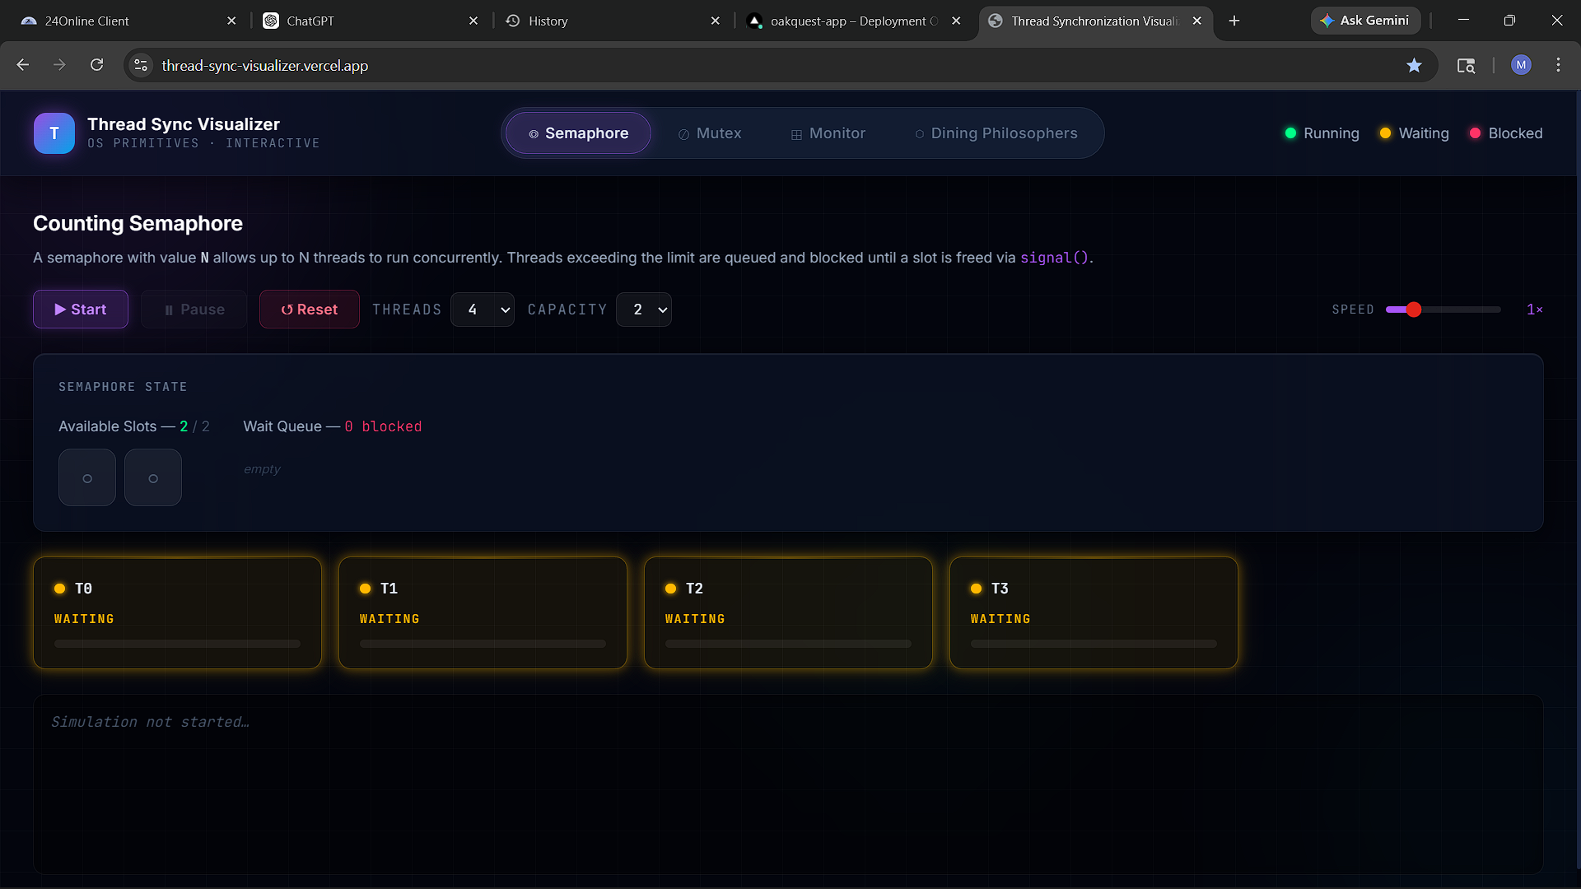
🔵 Counting Semaphore — Initial State
WAITING
4 threads ready to compete for 2 slots. All sitting in Waiting state — yellow, calm, and queued. The P/V storm hasn't started yet ⚡
3 / 10

Slide 4
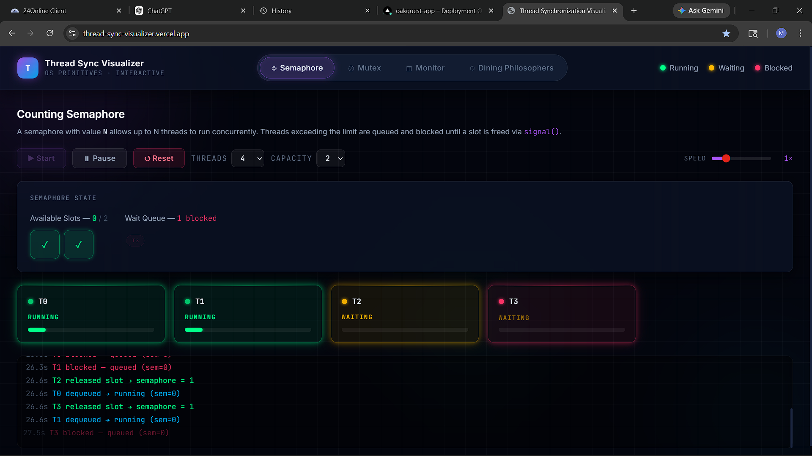
🟢 Counting Semaphore — Simulation Running
LIVE
T0 & T1 hold both slots (Running 🟢). T2 is still Waiting. T3 is Blocked 🔴 in the FIFO queue. Watch the timestamps in the log — this is P/V in action.
4 / 10

Slide 5
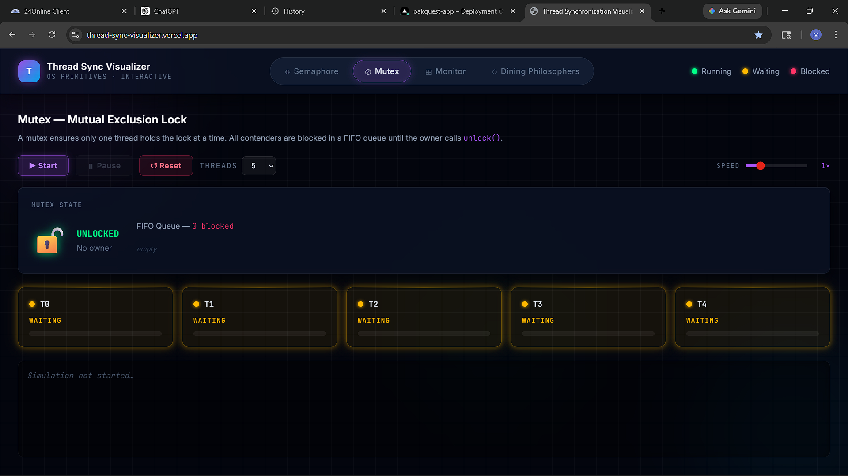
🔓 Mutex — Mutual Exclusion Lock · Initial State
UNLOCKED
5 threads. One lock. Zero owners. Everyone is politely waiting — but only one will ever get in at a time. Fairness is guaranteed via FIFO wake semantics.
5 / 10

Slide 6
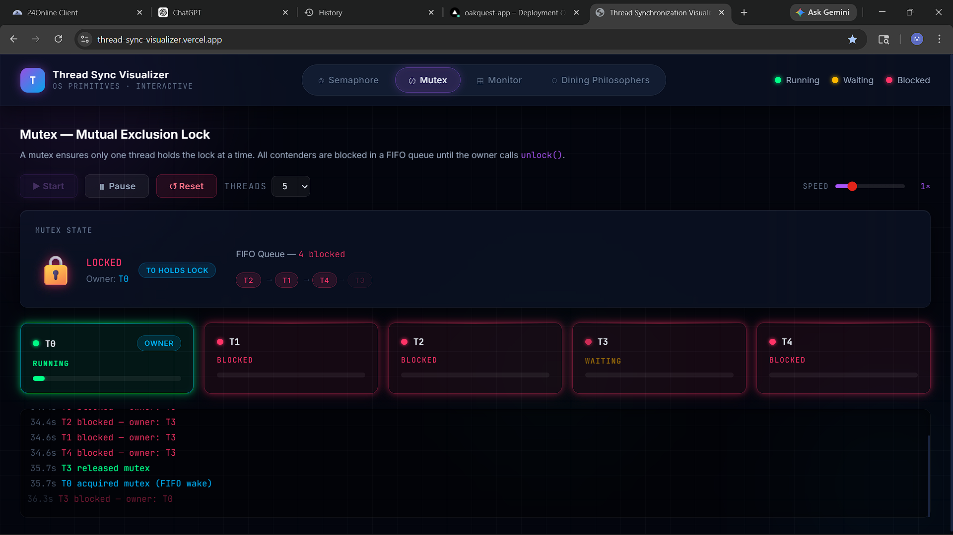
🔐 Mutex — Lock Contention Live
LOCKED
T0 owns the lock (OWNER badge 🏆). T1, T2 & T4 are Blocked 🔴 in FIFO order. Log shows T3 released → T0 acquired via FIFO wake. One owner. Always.
6 / 10

Slide 7
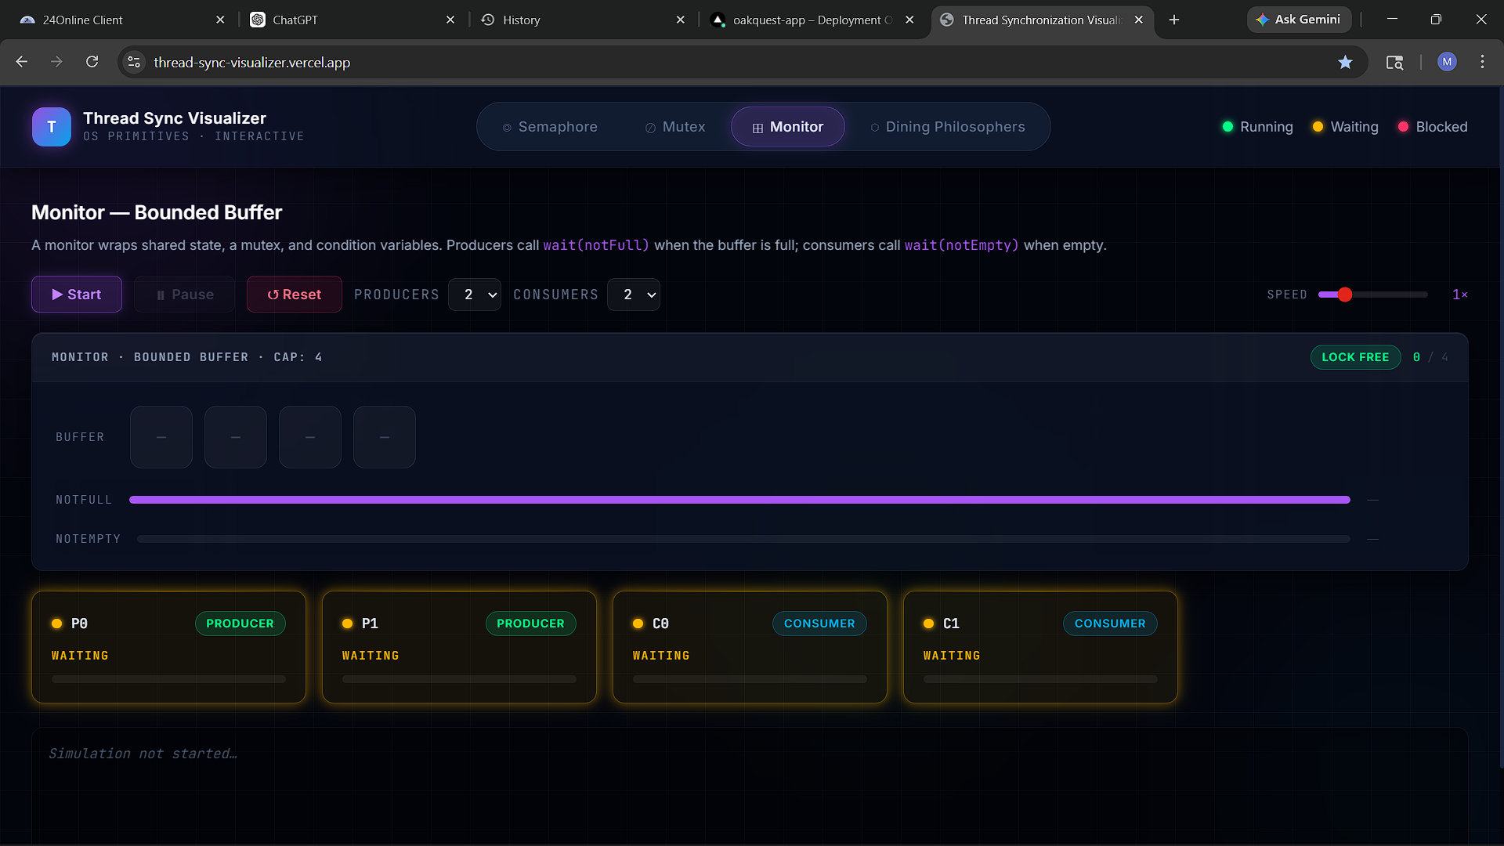
📦 Monitor — Bounded Buffer · Initial State
LOCK FREE
2 Producers, 2 Consumers, buffer cap 4. notFull bar is maxed — room to produce. notEmpty is flat — nothing to consume yet. Classic Hoare monitor, ready to go.
7 / 10

Slide 8
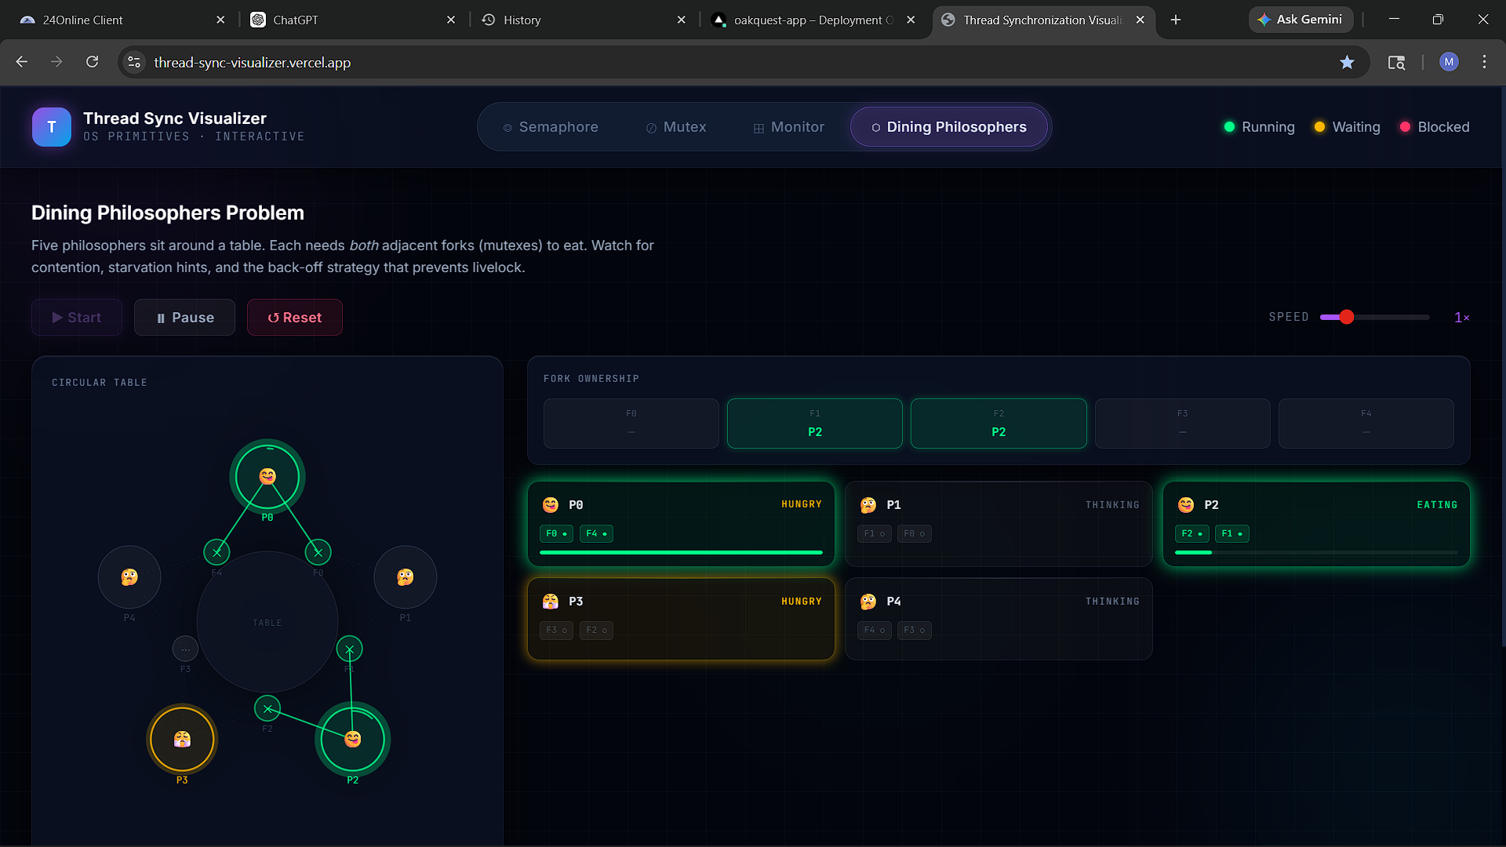
🍽️ Dining Philosophers — Back-off in Action
EATING
P2 is Eating 🟢 — holding forks F1 & F2. P0 and P3 are Hungry but blocked. The back-off strategy releases one fork if the other is taken. No deadlock. Ever. ✅
8 / 10

Slide 9
⚙️ How It's Built
100% client-side · Zero backend · Deploy anywhere
⚛️ React 18 + Vite 5
🎨 Tailwind CSS + Framer Motion
SPA architecture with HMR. AnimatePresence powers smooth tab transitions between modules.
Dark-mode utility-first styling with fluid animations on every thread state change.
🧠 Dual-Layer State Engine
🚀 Vercel Deployment
useRef drives the simulation (no re-renders). useState drives the UI. Like a game-engine physics loop.
Static build via npm run build. Deployed in seconds. No server, no config, no friction.
🌐 thread-sync-visualizer.vercel.app
9 / 10

Slide 10
🚀
Try It. Break It.
Learn From It.
Free, zero-install, works in any browser.
For CS students, OS instructors, and anyone who finds concurrency fascinating.
🌐
Live Demo
thread-sync-visualizer.vercel.app
💻
GitHub
https://github.com/Realco037/Thread-Sync-Visualizer
🎓
LPU · CSE 316 · B.Tech CSE
Jan – May 2026
10 / 10

